Slide 1

ONOS
Open Network Operating System
Teaching brigade, ONF
Andrea Campanella, ONF, USA
Abdulhalim Dandoush, ESME-SUDRIA, France
Lefteris Manassakis, ICS FORTH, Greece
ONOS Build, SAMSUNG Seoul
September 20, 2017

Slide 2
General Information
WIFI
SSID: onos_creative_<number>
PWD: onosbuild2017
Charge laptops downstairs if you need
Notes:
In general, ONOS announce a new release every Quarter. The latest release was Loon

Slide 3
Links and Virtual Machine
Introduction: https://goo.gl/Vk1gjh
Installation: https://goo.gl/1BjLWa
Apps: https://goo.gl/fB5yfJ
VM : https://goo.gl/i1d9Rs
Notes:
In general, ONOS announce a new release every Quarter. The latest release was Loon

Slide 4
What is ONOS?
Open Network Operating System (ONOS) is an open source SDN network operating system. Our mission is to enable Service Providers to build real SDN/NFV Solutions.
Quarterly Releases, Loon (1.11.0) - released 2017-10
Notes:
In general, ONOS announce a new release every Quarter. The latest release was Loon

Slide 5
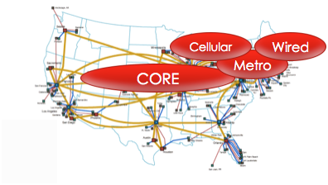
Service Provider Networks
WAN core backbone
Multi-Protocol Label Switching (MPLS) with Traffic Engineering (TE)
200-500 routers, 5-10K ports
Metro Networks
Metro cores for access networks
10-50K routers, 2-3M ports
Cellular Access Networks
LTE for a metro area
20-100K devices, 100K-100M ports
Wired access / aggregation
Access network for homes; DSL/Cable
10-50K devices, 100K-1M ports
Notes:
Now… just to make sure that everyone appreciates the size of the problem, here is a brief look/glance at some numbers involved in a typical provider network. As you can see, we’re dealing with 10’s of thousands of devices and millions of ports.

Slide 6
Architectural Tenets/principles
High-availability, scalability and performance
Strong abstractions and simplicity to develop apps and solutions
Protocol and device behaviour independence
Separation of concerns and modularity
Notes:
As you can imagine, such numbers translate into some daunting requirements, both in terms of throughput and total size of data. It’s not unusual to be having to provision close to a million of paths per second, which is something that translates into nearly an order of magnitude more of operations on the network state.
Now, sure… this is nowhere near a big data problem, but let’s not forget the fact that most of such operations also have stringent latency requirements and that the entire setup has to be highly available.
So as you can see, it becomes quite a difficult challenge to balance what are at times mutually competing requirements. I’ll discuss later how ONOS approaches some of these problems.

Slide 7
GUI
REST API
ONOS applications
ONOS networking core
Command Line
ONOS distributed applications platform
OSGI / Apache Karaf

Slide 8
GUI
REST API
ONOS applications
ONOS networking core
Command Line
ONOS distributed applications platform
OSGI / Apache Karaf

Slide 9
GUI
REST API
ONOS extensions
applications
drivers
protocols
ONOS networking core
Command Line
ONOS distributed applications platform
OSGI / Apache Karaf

Slide 10
GUI
REST API
ONOS applications
ONOS networking core
Command Line
ONOS distributed applications platform
OSGI / Apache Karaf

Slide 11
Distributed Core

Slide 12
ONOS Distributed Architecture
Distributed
Set up as a cluster of instances
Symmetric
Each instance runs identical software and configuration
Fault-tolerant
Cluster remains operational in the face of node failures
Location Transparent
A client can interact with any instance. The cluster presents the abstraction of a single logical instance
Dynamic
The cluster can be scaled up/down to meet usage demands

Slide 13



Slide 14
tcp:9876

Slide 15


ONOS Cluster
ONOS 1
ONOS 2
ONOS 3

Slide 16


Closer look...
Notes:
You have a set of controllers that coordinate with each other to perform the role of a logically centralized control plane.

Slide 17
Notes:
The switches when they boot up connect to one or more controllers. This is something that is supported in Openflow

Slide 18

Notes:
The controllers coordinate with each other to elect a master and from the new master communicates this decision to the switch and from that point on the switch exclusively communicates with its master.

Slide 19

Notes:
If one controller fails,

Slide 20
Notes:
the switches automatically failover to the backup controller and you have everything up and running with zero downtime.

Slide 21
Notes:
In this new setup, the network is essentially divided up amongst the controllers. While this is great for redundancy and scale this raises some new challenges which did not exist earlier.

Slide 22

State Management in ONOS
Better if applications can focus on business logic
Primitives span the consistency continuum
EventuallyConsistentMap<K, V>
Map abstraction with eventual consistency guarantee
ConsistentMap<K, V>
Map abstraction with strong linearizable consistency
LeadershipService
Distributed Locking primitive
DistributedQueue<E>
Distributed FIFO queue with long poll support
DistributedSet<E>
Distributed collection of unique elements
share nothing
strong
weak

Slide 23

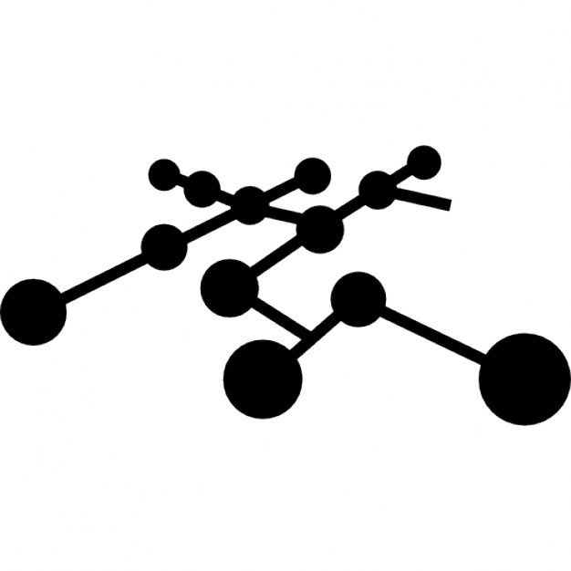
Northbound
intents
resources
network config
network-centric

Slide 24
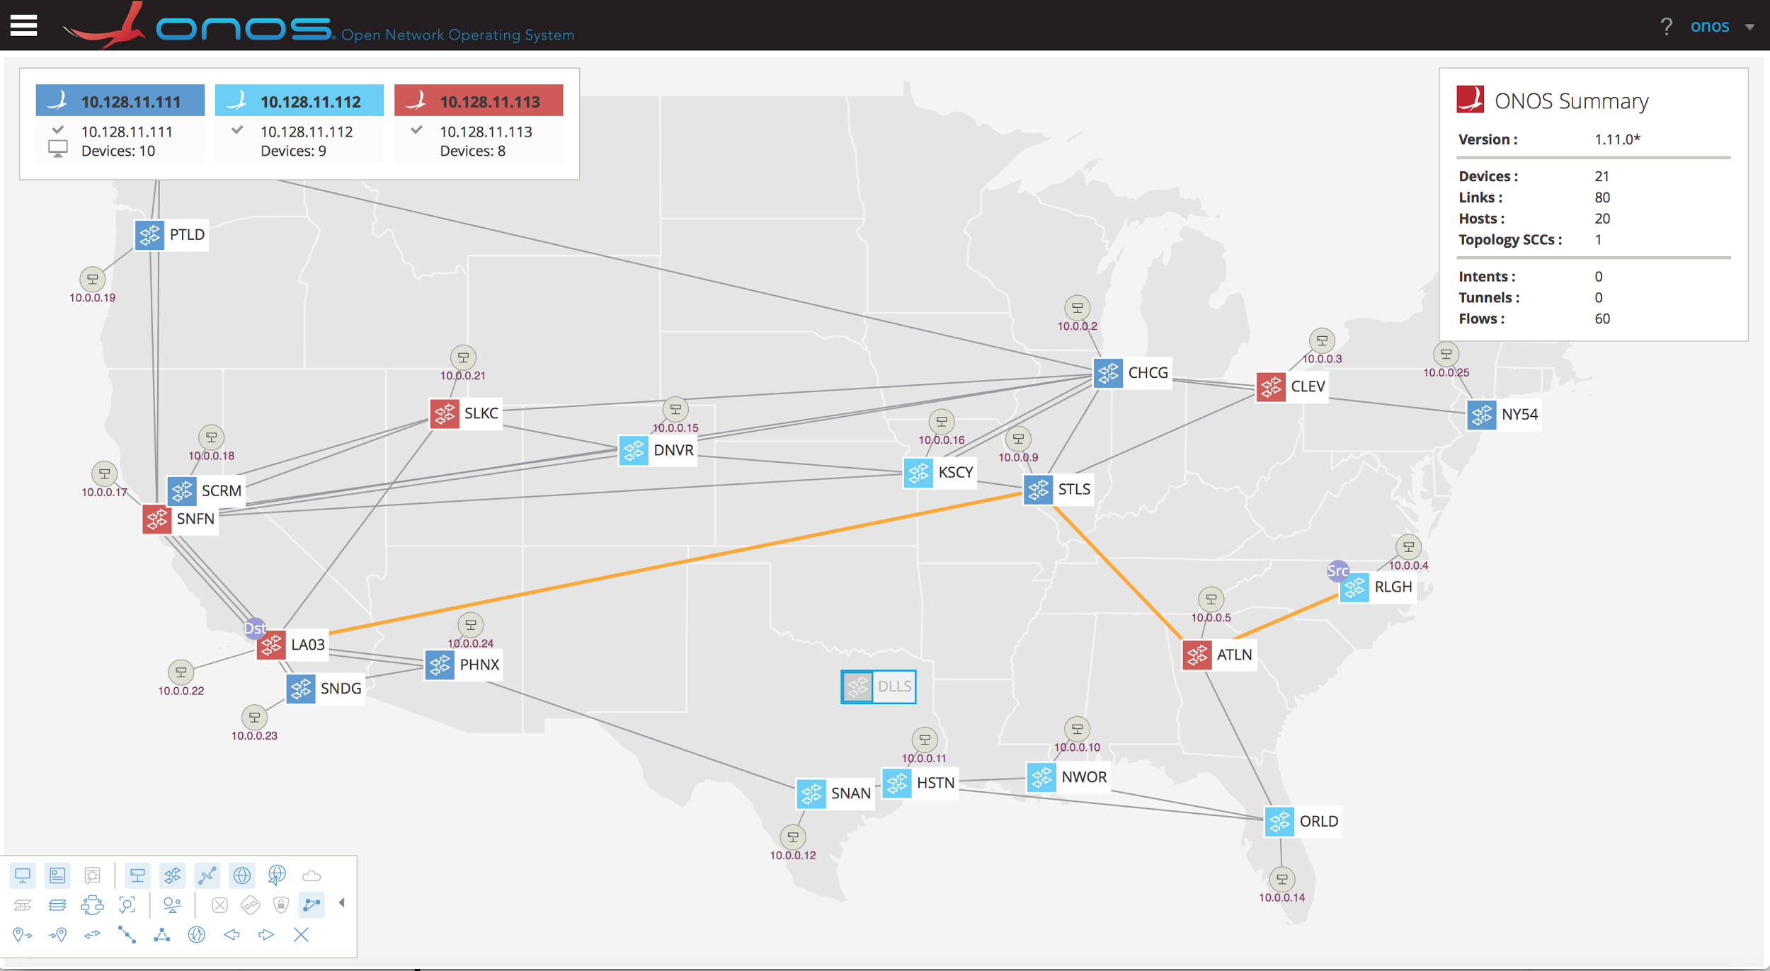

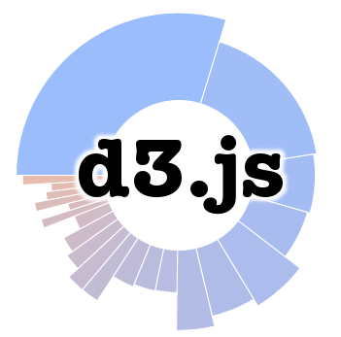


Interact with ONOS: GUI
UI: <onos-ip>:8181/onos/ui
Notes:
So I am going to tell you about a new abstraction in ONOS called Flow Objectives but before that let me set the stage a little.
SDN is supposed to enable to run simpler networks with hardware that could potentially come from different vendors with different pipelines. But currently, SDN application are either completely oblivious to pipelines causing them to make inefficient use of flow table space or they are written with full pipeline knowledge which binds them tightly to a hardware device. This is clearly unacceptable and defeats the value proposition of SDN.

Slide 25
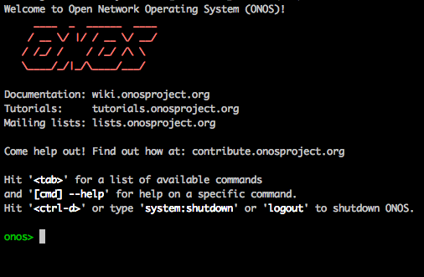
Interact with ONOS: CLI
$onos <controller_address>
Notes:
So I am going to tell you about a new abstraction in ONOS called Flow Objectives but before that let me set the stage a little.
SDN is supposed to enable to run simpler networks with hardware that could potentially come from different vendors with different pipelines. But currently, SDN application are either completely oblivious to pipelines causing them to make inefficient use of flow table space or they are written with full pipeline knowledge which binds them tightly to a hardware device. This is clearly unacceptable and defeats the value proposition of SDN.

Slide 26
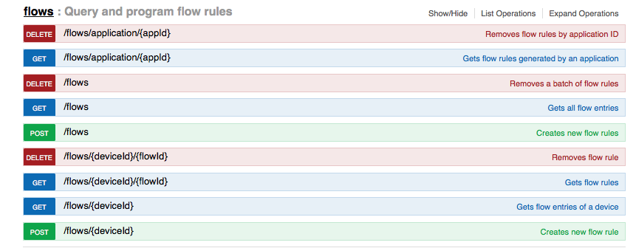
Interact with ONOS: REST and GRPC
REST APIs: <onos-ip>:8181/onos/v1/docs/
Northbound GRPC with protocol buffers (.proto)
for ONOS network model
Notes:
So I am going to tell you about a new abstraction in ONOS called Flow Objectives but before that let me set the stage a little.
SDN is supposed to enable to run simpler networks with hardware that could potentially come from different vendors with different pipelines. But currently, SDN application are either completely oblivious to pipelines causing them to make inefficient use of flow table space or they are written with full pipeline knowledge which binds them tightly to a hardware device. This is clearly unacceptable and defeats the value proposition of SDN.

Slide 27
Interact with ONOS
gRPC:
Google remote procedure call
Based on protobuf
Faster than REST
Off-Platform applications
RESTCONF
Rest interface for the XML-based rpc and streaming
operations
Notes:
Rather than provide a taxonomy of the various APIs available in the ONOS platform, I hope to describe some of the properties and rationale for these APIs. ... illustrated by examples.

Slide 28
Key Northbound Abstractions
Network Graph
Directed, cyclic graph comprising of infrastructure devices, infrastructure links and end-station hosts
Flow Objective
Device-centric abstraction for programming data-plane flows in table pipeline-independent manner
Intent
Network-centric abstraction for programming data-plane in topology-independent manner
Notes:
This is a problem... complex... lots of code.
Provide a generalized mechanism for describing, processing and installing these objectives.
consistent behavior for failures

Slide 29
Network Programming
Abstract
to
concrete
Intent
Host-Host
Single-Point to Multi-point
Protected
Intent
Flow Objective
OFDPA Pipeline
Single Table Pipeline
P4 program
Defined Pipeline
Flow Rule
Mapping through drivers
OF
P4Runtime
Netconf
TL1
Notes:
There are currently three layers of flow programming abstraction.
The first is flow rules and it abstracts the protocol used to program a forwarding table, like OF, NETCONF, SNMP, OpenFlow, OpFlex, TL1, etc. and it provides some portability between control protocols. This abstractions enables application developers to avoid the different ways each of the protocols accomplish similar objectives and the differences in fields and abstraction between versions of the same protocol. Network applications that are built for one or more protocols are effectively locked into a specific set of devices or vendors, and they tend to increase in complexity as they become more universal.
Flow Objectives
Many forwarding devices expose more than one table, and each is individually programmable through the Flow Rule service. It is quite common that each table has different restrictions and capabilities about which headers can be matched and which transitions are permitted. These details are made available to network application programmers by hardware vendors, but this has typically meant that applications need to be customized to the tables and pipelines of each individual device. In simple or fairly homogeneous networks, this task is fairly tractable, but it quickly grows in complexity with the number of devices. This customization also makes applications less portable between different types of devices, which can facilitate vendor lock-in.
Standards organizations, like the ONF, have tried to address this issue by defining table type patterns (TTPs), each of which defines a table pipeline. Forwarding devices can provide a list of supported TTPs, and network controllers can negotiate which TTP to be used. However, network application programmers using TTPs are still exposed to the complexity of managing individual tables and may still need to write their applications to support a variety of different TTPs. TTPs are also fairly inflexible to new pipelines. Traditionally, this inflexibility has mirrored the inflexibility of hardware pipelines. However, the introduction of NPUs, forwarding FPGAs, and programmable forwarding ASICs, as well as the rise in software-based forwarding (like OVS and CPqD), has enabled reconfigurable and custom pipelines that would require new TTPs. Flow objects provide a generic ONOS pipeline that gets mapped to different tables through pipeline drivers.
Intent
Finally, many applications do not want to think about configuration or programming at the per-device level, and the intent interface offers an network centric abstraction. Applications become more portable and compilers are used to map these network centric requests into the device rules and configuration required to realize them.

Slide 30
Flow Objectives

Slide 31
Flow Objective Architecture
Device driver is used to translate objectives to the specific flow rules for a given device and pipeline
Apps
Flow Objective
FlowObjective Service
C
O
N
T
R
O
L
L
E
R
Pipeliner API
D
E
V
I
C
E
D
R
I
V
E
R
S
CorsaPipeliner
Juniper Pipeliner
OFDPA Pipeliner
OFFLowRuleProvider
Juniper
FlowRuleProgrammable
OFFLowRuleProvider
Open Flow 1.0 Rule
Open Flow 1.3 Rule
Netconf XML
Physical Device
Corsa Pipeline
Juniper Pipeline
HP Pipeline

Slide 32
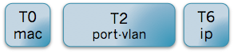
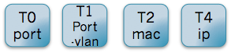
Flow Objective example
Peering Router
Match on Switch port, MAC address, VLAN, IP
FlowObjective Service
CorsaPipeliner
OFDPA Pipeliner
CorsaPipeline
OFDPA Pipeline
Notes:
The drivers then know how to map these fields to the correct tables for the different devices. So for example, MAC address are inserted into table 0 in the corsa switch and in table 2 in the OF-DPA based switch.

Slide 33
Flow Objective Summary
Flow Objective: abstraction for applications to be pipeline unaware while benefiting from multi-table architectures
Enable app portability
interoperability between different type of pipelines coexisting in heterogenous networks.
Support for a new pipeline is achieved through a new pipeliner behaviour in a driver. The new pipeline is then programmable from all existing applications.

Slide 34
Intent Framework
Provides high-level, network-centric interface that focuses on what should be done rather than how it is specifically programmed
Abstracts unnecessary network complexity from applications
Maintains requested semantics as network changes
High availability, scalability and high performance
Notes:
To solve these problems and more generally make it easier to write applications, we have built the Intent Framework as an abstraction layer.
Provide a flexible, high-level interface for declaring global network policy
Allow applications and operators to describe policy rather than device instructions
Abstract network complexity from higher layers
Extend easily to produce more complex functionality through combinations of other intents

Slide 35

Intent Example
Application
Java,Rest,gRPC
CREATION
Host to Host Intent
Notes:
To be more concrete, I would like to illustrate this using a simple example, using the same application objective. An application begins with by defining a high level object defined requests connectivity is established between specific hosts. That object is submitted to the Intent framework that will be responsible for processing it. The Intent Framework will first transform the intent into more specific intent objects through a process called compilation. Once the intents that contain enough information that they can be programmed, we convert these lower-level intents into resource reservations and work in a process called installation.

Slide 36
Intent Example
Host to Host Intent
submit()
Intent Service API
Notes:
To be more concrete, I would like to illustrate this using a simple example, using the same application objective. An application begins with by defining a high level object defined requests connectivity is established between specific hosts. That object is transformed into more specific intent objects through a process called compilation. Once the intents that contain enough information that they can be programmed, we convert these lower-level intents into resource reservations and work in a process called installation.

Slide 37


Intent Example
Host to Host Intent
COMPILATION
Path Intent
Path Intent
Notes:
To be more concrete, I would like to illustrate this using a simple example. We begin with a high level object defined by the application that requests connectivity is established between specific hosts. That object is transformed into more specific intent objects through a process called compilation. Once the intents that contain enough information that they can be programmed, we convert these lower-level intents into resource reservations and work in a process called installation.

Slide 38
Intent Example
Host to Host Intent
COMPILATION
Path Intent
Path Intent
INSTALLATION
Flow Rule Batch
Flow Rule Batch
Flow Rule Batch
Flow Rule Batch
Notes:
To be more concrete, I would like to illustrate this using a simple example. We begin with a high level object defined by the application that requests connectivity is established between specific hosts. That object is transformed into more specific intent objects through a process called compilation. Once the intents that contain enough information that they can be programmed, we convert these lower-level intents into resource reservations and work in a process called installation.

Slide 39
Intent Framework Summary
Intents are a network-centric programming abstraction that reduce application complexity.
Intents provide device-agnostic behavior with persistency and high performance across network failures.
Intent framework has moved from prototype to production deployments.

Slide 40
Failures in Intents

Slide 41
Reaction to failures for intents
All the intents that are involved in the failure will be re-compiled with a multi-threading process that:
removes the old failed intents
finds a new entire path from source to destination
generates new Installable Intents (i.e., FlowRule/FlowObjective Intent)

Slide 42
Configuration
Network Configuration (netcfg)
Provides mechanism for any service to register and receive configuration
Device Configuration
Behaviors abstract the management and configuration aspects of a device
Dynamic Configuration
Enables YANG-based service models to be introduced at runtime
Allow applications to implement dynamic services
Notes:
Lastly, I want to briefly mention some of the configuration options available in ONOS.
Many services require configuration that cannot be observed from the environment. The Network Configuration service provides a repository for the registration, update, and retrieval of configuration from device metadata, name or location, to network application parameter configuration.
For the configuration of devices, specifically, we can expose various behaviors of different devices through projections. Behaviors abstract the management and configuration aspects of a device, and generally, are protocol and vendor independent. We see behaviors reused across multiple devices and protocols in several contexts (including flow table mapping and port configuration).

Slide 43
Dynamic Config

Slide 44
Control and Configuration
Operators need a resilient and scalable platform capable of both control and configuration
control
configuration
platform
Notes:
Consequently, operators need a resilient and scalable platform that provide both control and configuration capabilities at the same time.
The benefits of being able to accomplish both from the same vantage point are fairly clear and numerous.

Slide 45
Dynamic Configuration
*.yang
YANG Compiler
Device Certification App
Device Config
App
Network
Function
JSON / XML
model.jar
REST / gRPC / RESTCONF / NETCONF NB
Distributed Config Store
YANG Runtime
Dynamic Config Subsystem
/devices
/services
*.yang
model.jar
RESTCONF / NETCONF SB
JSON / XML
Device
Device
Device
Device
Device
Device
Device
Device
Device

Slide 46
Southbound

Slide 47
Southbound overview
Southbound protocols in 1.11.0:
OpenFlow until 1.3 + optical extension, 1.5 is implemented and under testing
OVSDB
NETCONF + YANG → Yang tools and Yang management system
SNMP
P4 → thrift api for bmv2 softswitch from barefoot networks. → p4Runtime
BGP, ISIS, OSPF → interoperability with legacy network.
PCEP → Path computation element protocol (IETF)
REST and RESTCONF
LISP
TL1
gRPC

Slide 48
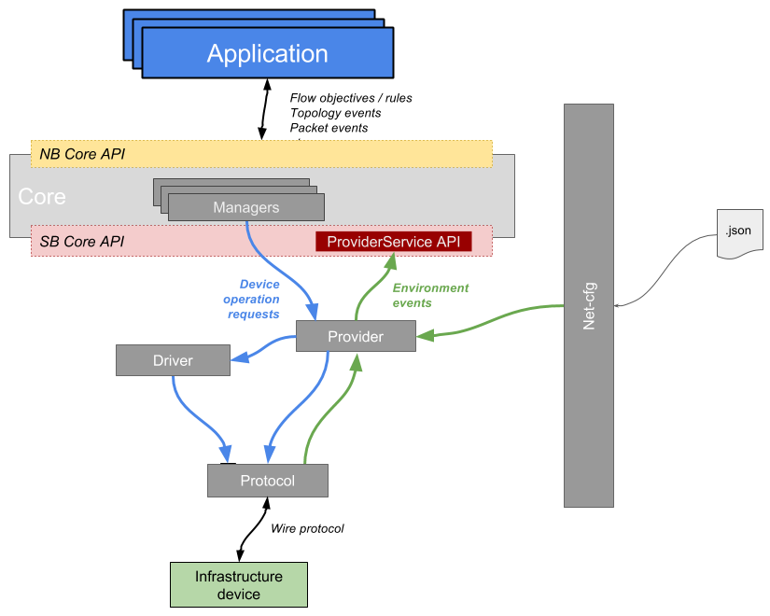
Providers, protocols and drivers
ONOS interacts with the underlying network with the help of its Providers.
Providers: hide complexity from upper layers, used by the core to (re)act on the network
Protocols: Features and modules to communicate with devices
Drivers: define specific capabilities offered by the device
Notes:
Providers abstracts the configuration, control and management operations of a specific family of devices (e.g. OpenFlow, SNMP, Netconf, etc.).
Providers can notify the core about events using the ProviderService API.

Slide 49
ONOS Protocols
Features and modules to communicate with devices
Expose the standard set of APIs and enabled operations. I.e:
OpenFlow: FlowMods, GroupMods, etc
Rest: implements CRUD operations (GET, POST, DELETE, etc...)
Netconf: Open/close session, setConfiguration, getConfiguration
Usually leverage 3rd party communication libraries → openflowj, snmp4j, thrift
Provider
Provider
Behaviour
Provider
Component
Provider
Component
Protocols

Slide 50
ONOS Providers
Providers are used by the core to (re)act on the network:
Up/down of device, links
DeviceProvider, LinkProvider
Provisioning of rules, paths, tunnels
FlowRuleProvider, TunnelProvider
Process packets, notifications/alarms
PacketProvider, AlarmProvider
→ Translate to and from Core abstractions into protocol or behaviours calls.
Provider
Component
Provider
Component
Protocols
This is where the magic happens

Slide 51
ONOS drivers
<driver name="default "manufacturer="ON.Lab"
hwVersion="0.0.1" swVersion="0.0.1">
<behaviour api=InterfacePath
impl=ImpementationPath />
</driver>
Device specific driver
collection of behaviors
on-demand activation
Abstraction via behaviors
define specific capabilities offered by the device
encapsulate specific logic and code
ports,controller,flowrule,power…
App
ONOS
Encapsulate single interaction
protocol
information
Driver
Driver
Protocol
Protocol

Slide 52
ONOS CORE Behaviours
<behaviour api=InterfacePath
impl=ImpementationPath />
APIs
DeviceDescritpionDiscovery → Device’s Description and Ports.
FlowRuleProgrammable → Translates to and from ONOS core FR abstraction in device specific calls
PacketProgrammable → Emit a given packet from a device.
GroupProgrammable → Translates to and from ONOS Groups
PortStatisticsDiscovery → Statistics of Device Ports.
Pipeliner → Pipeline abstraction, FlowObjectives to pipeline specific FR
Recently Introduced
DeviceHandshaker → device handshake for GeneralDeviceProvider.
PipelineProgrammable → Installs a Programmable Pipeline on the Device.

Slide 53
Example: FlowRuleProgrammable
Apply Flow rule request
Application or
ONOS subsystem
FlowRuleManager
of:0000000000000001
netconf:foo@1.2.3.4:567
OpenFlowRuleProvider
FlowRuleDriverProvider
DriverService
Southbound
FooFlowRuleProgrammable
driver: foo-netconf
behavior:
interface: FlowRuleProgrammable
impl: FooFlowRuleBehavior
OpenFlow
NETCONF
1.2.3.4:567

Slide 54
Applications

Slide 55
Developing ONOS applications
ONOS applications:
Interact with the northbound Java, REST, gRPC interface
Device and protocol agnostic
Augment ONOS though modularity
Provide GUI,REST,CLI and distributed stores.
Shape the network.
Easy to start with auto generated basic code via maven archetypes.

Slide 56
Example Applications
SDN-IP Peering
Connect internal BGP software daemon to external BGP routers
Install learned routes to forward IP traffic to appropriate egress point
Multi-level (IP / Optical) Provisioning
Provision optical paths/tunnels with constraints
Content Acquisition / Video Streaming (DirecTV)
Establish multicast forwarding from a sender to set of receivers
Virtual Network Gateway (vBNG)
Provide connectivity between a private host and the Internet
Bandwidth Calendaring
Establish tunnels with bandwidth guarantees between two points at a given time

Slide 57

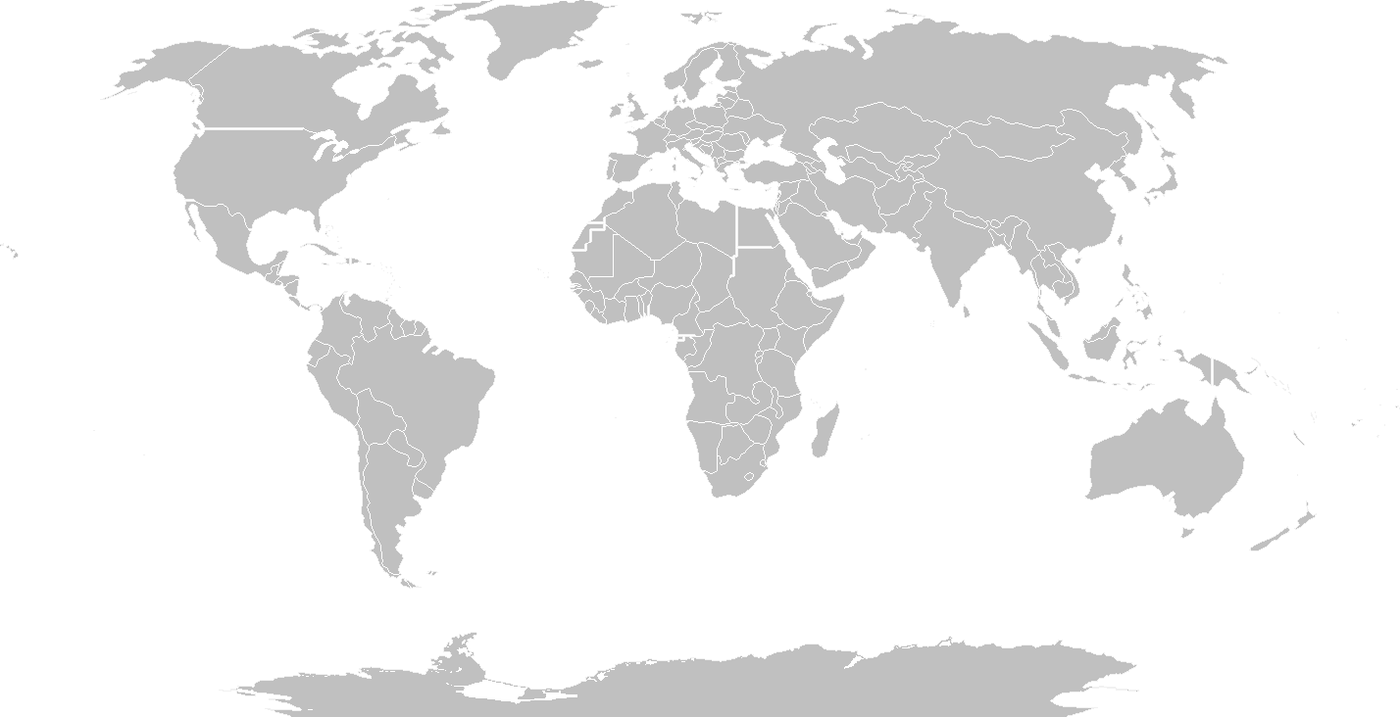

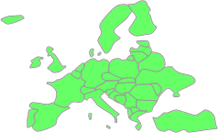




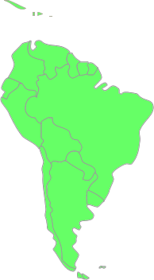





ONOS NREN Deployments
Expand
Deploy ONOS and its apps on your network
Guide
ONF provides resources, guides and tips to help your deployment
Share
ONF shares your deployment with the world
OF
Q3 2015
Korea announces the first
ONOS deployment
OpenFlow
Q1-Q2 2015
First ONOS Deployments
South America, US, EU
Q1 2016 – New connections
Miami - Korea
Miami - Taiwan
Korea - Taiwan
Q4 2015
ONOS deployed in Korea
Q1 2016
NCTU / Taiwan
deploys ONOS
Q4 2015 – New connections
Sidney – Seattle - Miami
Sao Paolo – Amsterdam
OpenFlow
Q4 2015
First ONOS
production deployment
in South America
OpenFlow
Q3 2015
ONOS Deployment in Australia
eBGP over L2 dedicated circuits

Slide 58

System Requirements for ONOS
Hardware requirements are difficult to define. They depend on:
Cluster size (i.e., # of instances),
Managed network size (e.g., devices, links, ports, etc.)
Number of messages exchanged with network devices
Number of flows
Basic requirements for learning/testing
2 core CPU
2~4 GB RAM
10 GB hdd
1 NIC (any speed)
Notes:
In fact, it is difficult to define the requirements.

Slide 59

Andrea: andrea@opennetworking.org
Lefteris: manassakis@gmail.com
Abdulhalim:adandoush@gmail.com

Slide 60
Further reading
ONOS website:
http://onosproject.org
Tutorials, documentation and general reading at:
https://wiki.onosproject.org/
ONOS is on Github at:
https://github.com/opennetworkinglab/onos
Setup Tutorial
https://wiki.onosproject.org/display/ONOS/Installing+and+Running+ONOS
Screencasts:
https://wiki.onosproject.org/display/ONOS/Screencasts

Slide 61


Software Defined Transformation of Service Provider Networks
Join the journey @ onosproject.org

Slide 62
Intent State Machine
app request
InstallReq
compile started
add/update topo event
Compiling
compile failed
Failed
compile succeeded
Removed
from store
app request
Recompiling
Installing
compile failed
or same result
install failed
install succeeded
WithdrawReq
Withdrawn
Installed
app request
remove topo or flow event
Withdrawing
withdraw succeeded

Slide 63
ONOS and P4:
Runtime control

Slide 64
Today: P4Runtime
Program-independent runtime API for P4-enabled devices
gRPC-based, p4runtime.proto protobuf definition
Allow interacting with entities defined in a P4 program
Tables, counters, meters, externs, etc.
Independent from the actual instance of the P4 program
No code auto-generation
Specification is still work-in-progress by API WG
Must look at p4lang/PI code to understand device behavior

Slide 65
P4Runtime API in a nutshell
Write messages
Add/modify/remove entities (e.g. table entries, groups, etc.)
Blocking calls
Read messages
Read content of entities (e.g. to retrieve all entries of a table)
Non-blocking (async)
Allow to set/get forwarding pipeline
Based on p4info.proto definition of the pipeline
Bidirectional stream channel
For packet-ins, packet-outs, mastership notifications

Slide 66
Overview
Pipeline-agnostic applications
Pipeline-aware application
2 modes of operations:
Standard criteria, treatments
Pipeline-specific ones
Events (packet, topology,
etc.)
FlowObjectives, Intents
FlowRules
PI Flow Rule Translation Serv.
PI Pipeconf Serv.
PI Pipeconf
(.oar)
Core
Driver
Tofino
BMv2
Default
P4Runtime vX
gNMI vX
P4Runtime vX
gNMI vX
P4Runtime vX
gNMI vX
Protocol
gRPC Transp. Controller
protobuf, HTTP/2
new
Device
(BMv2, Tofino, etc.)
Notes:
2 modes of operation: flowrules with PiCriterion and PiInstruction

Slide 67
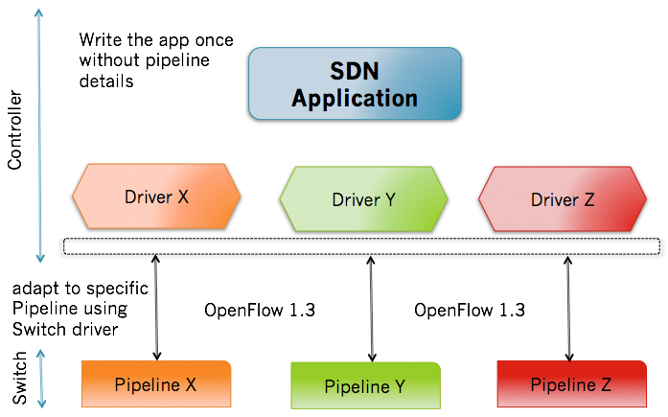
Flow Objective Abstraction
Problem: Applications currently must be pipeline aware, effectively making applicable on specific HW.
Flow objectives enable developers to write applications once for all pipelines
First attempt at interoperability between OF 1.3 switch
Notes:
Well using Flow Objectives your application can be written once and be run on any pipeline. The high level idea is to provide an abstraction layer which is consumed by a device driver who knows about their devices pipelines. The drivers then translate the the objectives to the appropriate rules or groups installed on the device.
Oh and this is the first time anyone has delivered interoperability between OF1.3 switches and that is pretty cool.

Slide 68
Flow rule provider architecture
Pi Pipeconf Manager
Flow Rule Driver Provider
getPipelineConfiguration(Device)
Pi Flow Rule Translation Service
Core
Get/Apply/Remove
FlowRule
Southbound
translate(FlowRule, Device)
P4 Runtime Flow Rule Programmable Impl
gRPC
controller

